Slide 1
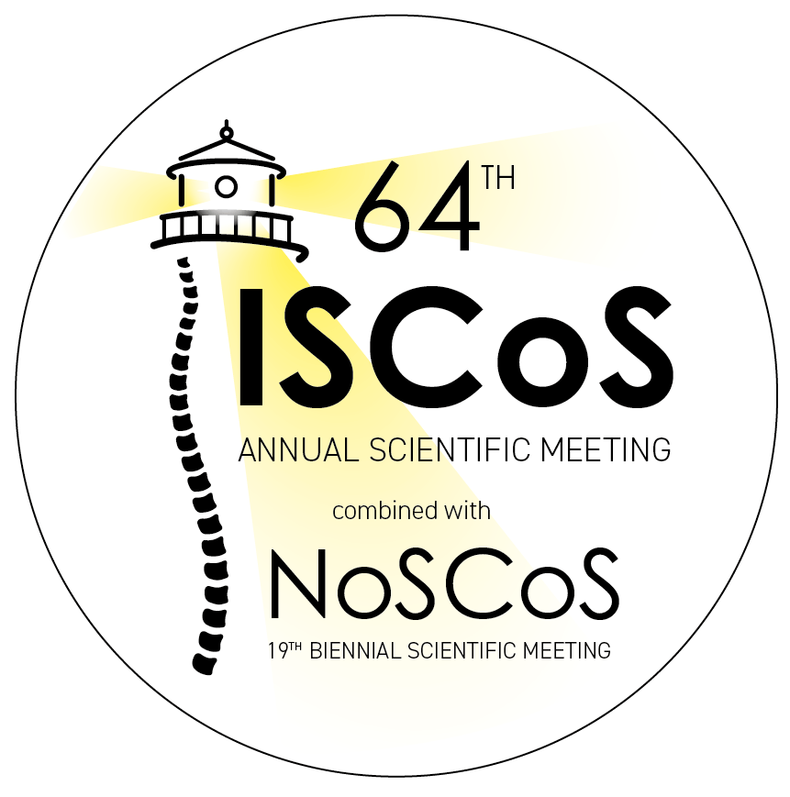




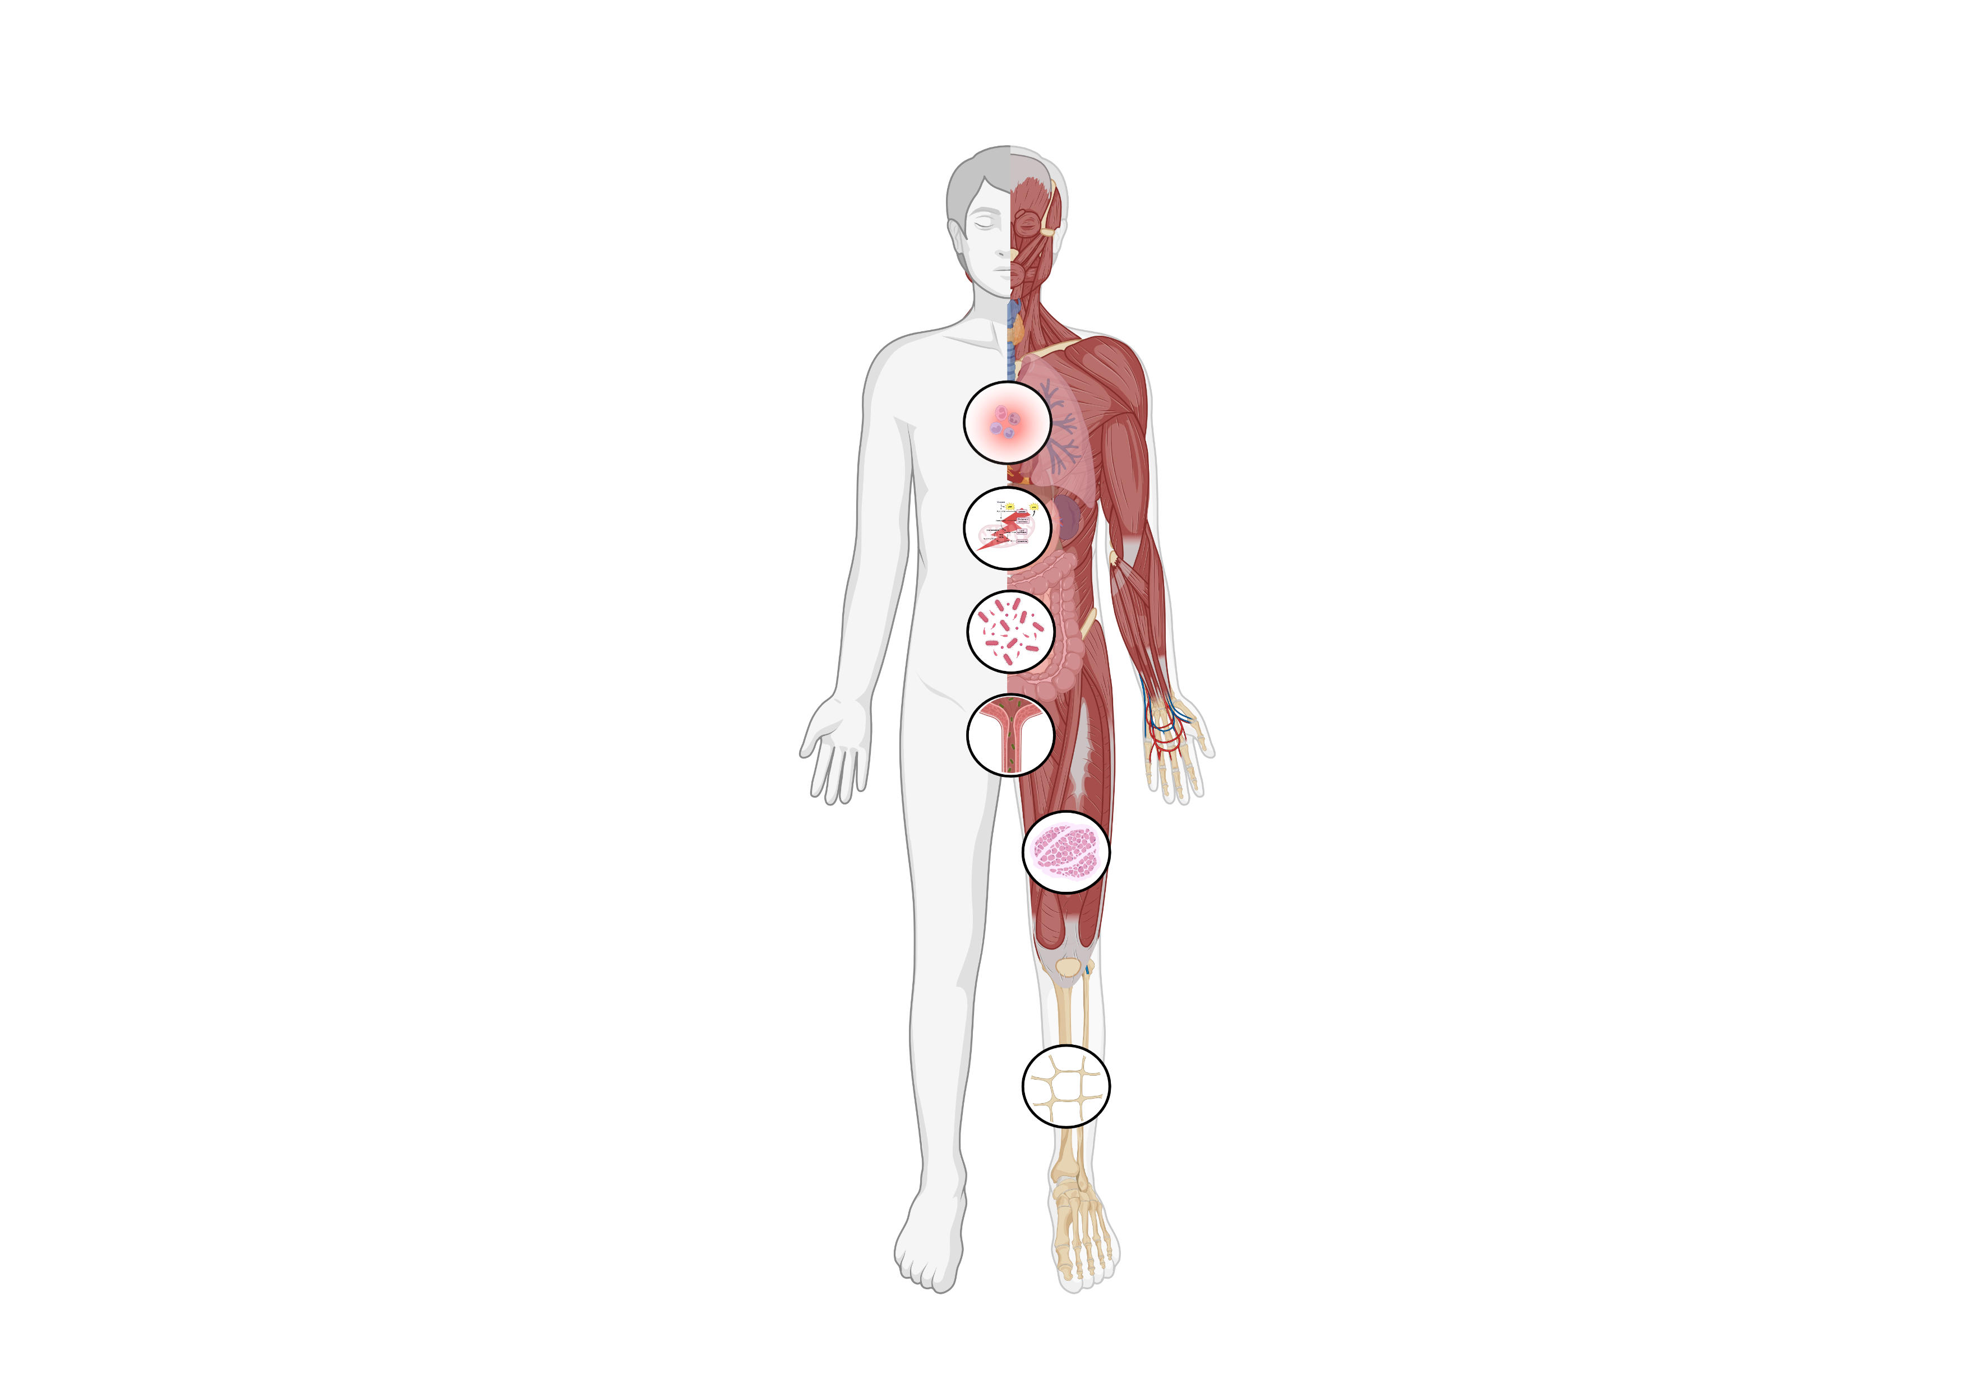
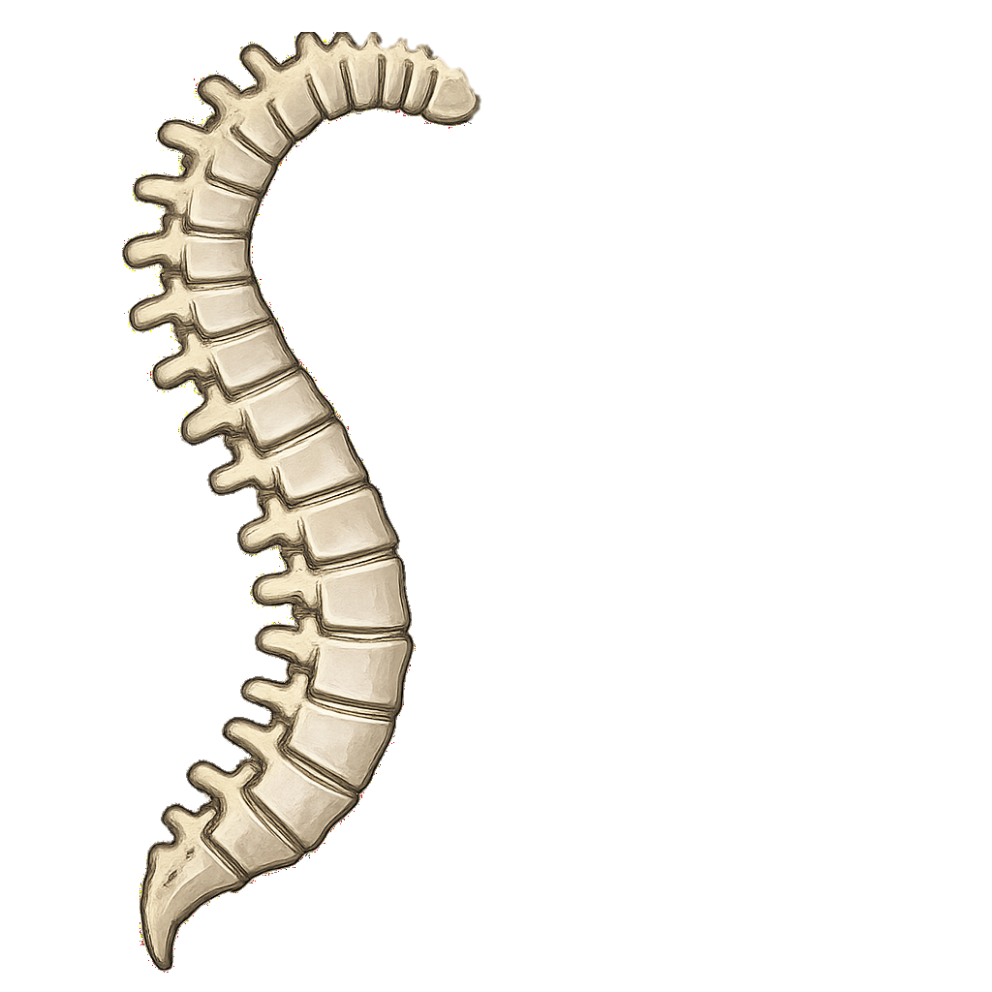
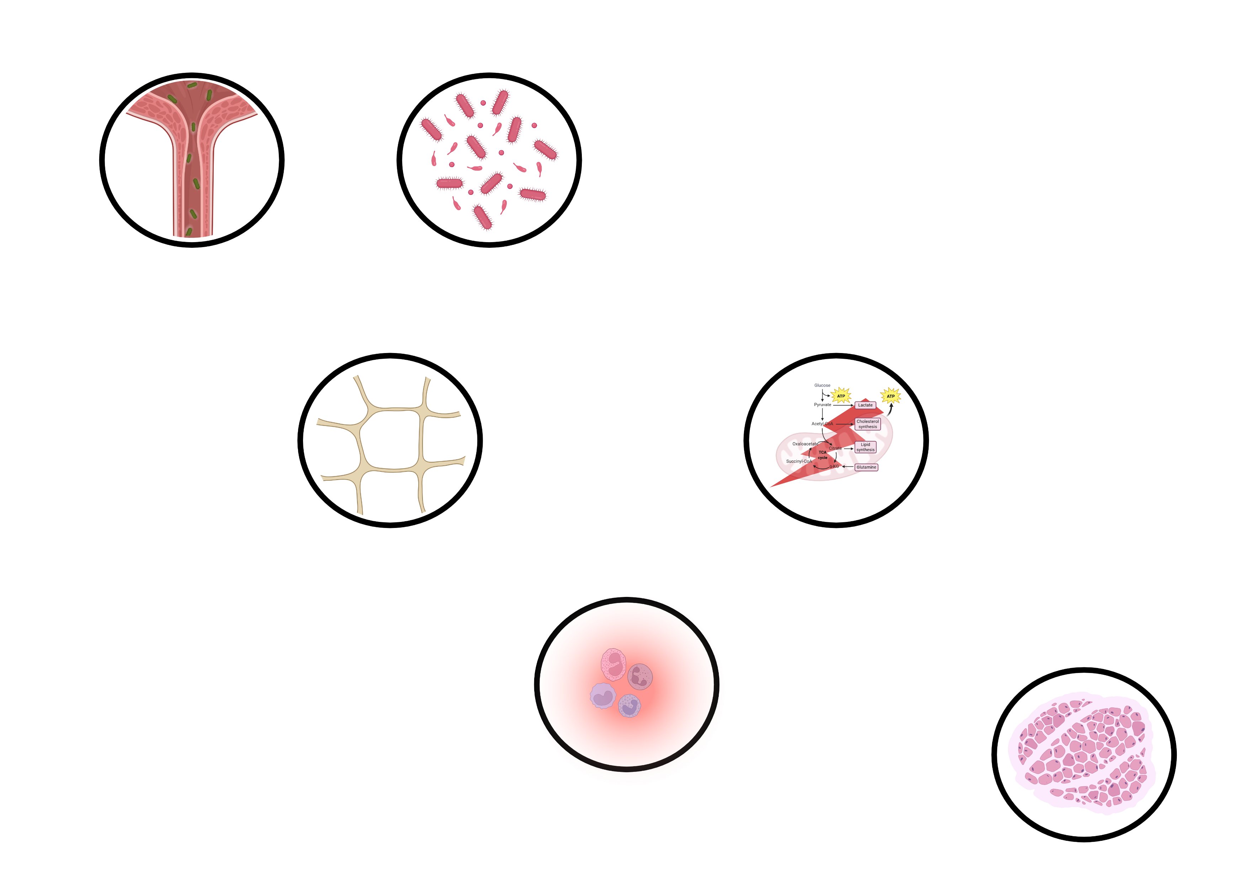















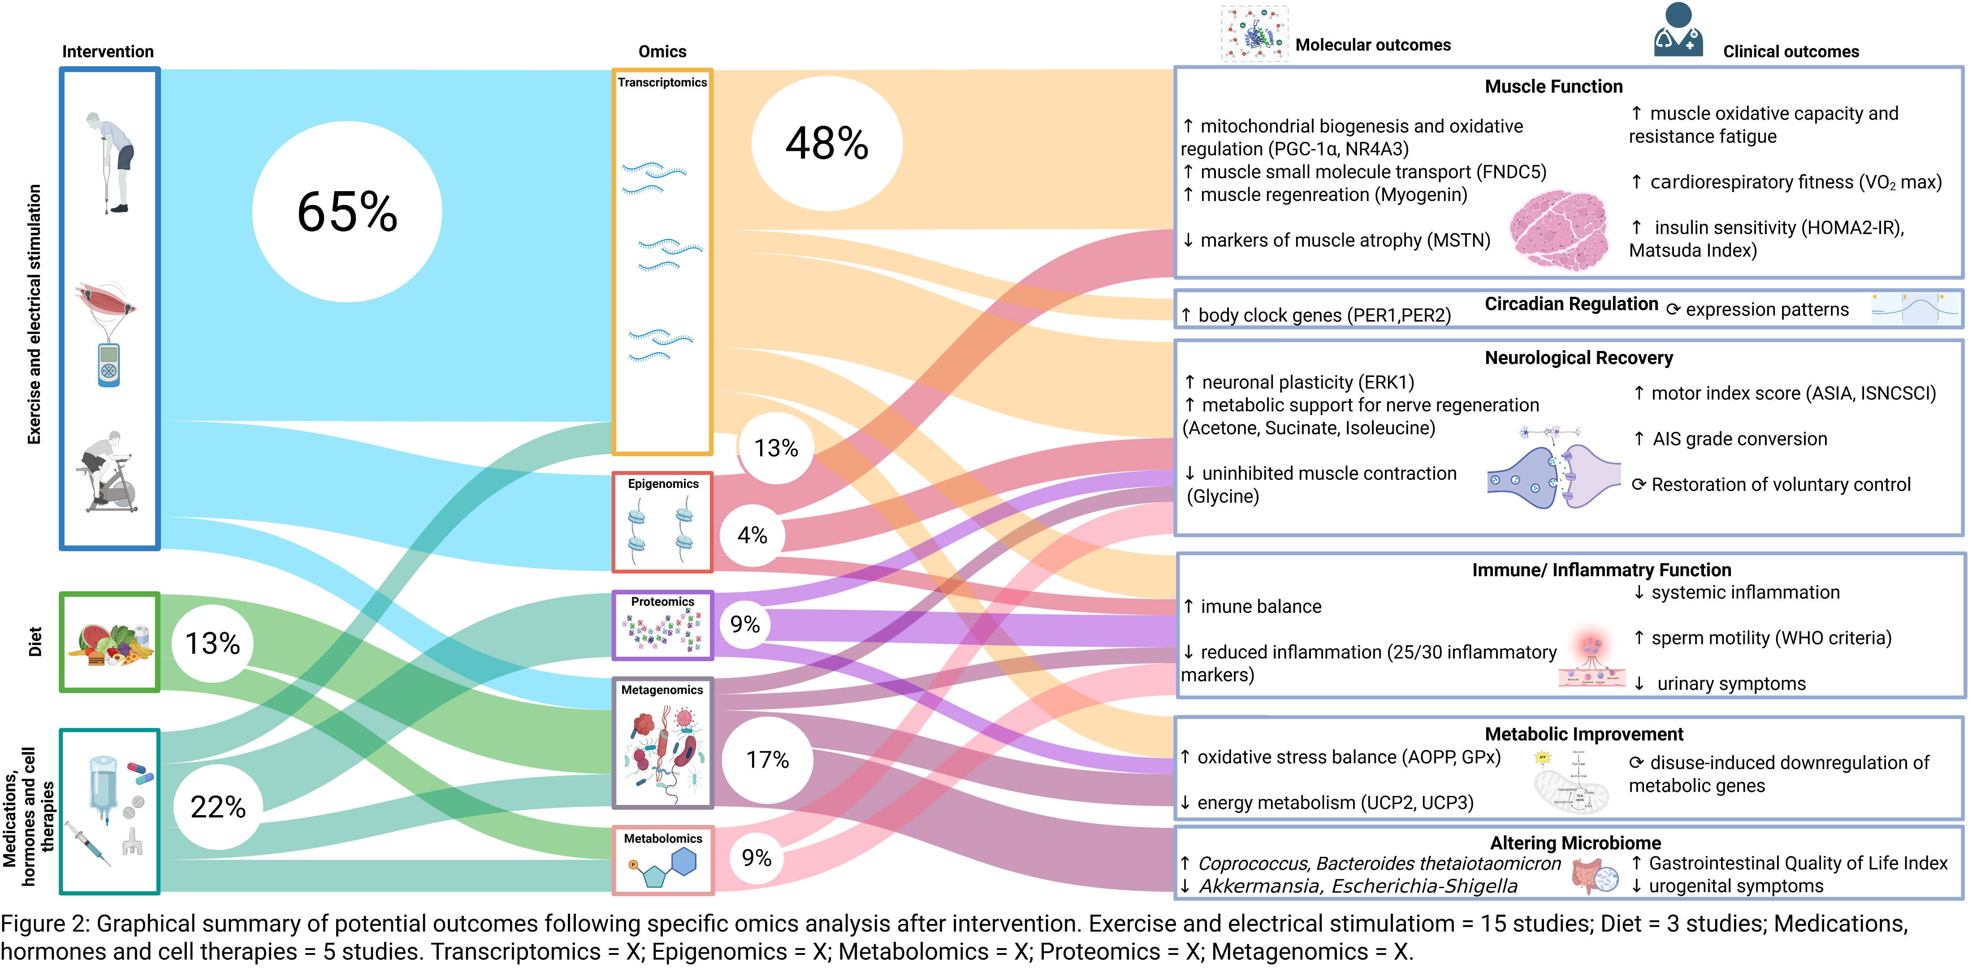
Implementing Omics Technologies to Analyze Rehabilitation Strategies in Spinal Cord Injury
Alexander Stacul^{1,2}, Ezra Valido¹, Nicole Nyfeler¹, Alessandro Bertolo^{1,3}, Ramona Maria Zeh¹, Andrea Fontana⁴, Carla Sabariego^{1,5,6}, Jürgen Pannek^{4,7}, Jörg Krebs⁴, Margaret Hund⁸, Xavier Jordan⁹, Onur Boyman^{10,11}, Alexander Leichtle¹², Marija Glisic^{1,3} and Jivko Stoyanov^{1,3}
¹Swiss Paraplegic Research, Nottwil, Switzerland; ²Graduate School for Cellular and Biomedical Sciences, University of Bern, Bern, Switzerland, ³Institute of Social and Preventive Medicine, University of Bern, Bern, Switzerland, ⁴Swiss Paraplegic Center, Nottwil, Switzerland, Clinical Trial Unit, Swiss Paraplegic Center, Nottwil, Switzerland, ⁵Faculty of Health Sciences, University of Lucerne, Lucerne, Switzerland, ⁶Center for Rehabilitation in Global Health Systems, WHO Collaborating Center, University of Lucerne, Lucerne, Switzerland, ⁷Department of Urology, Inselspital, Bern University Hospital, University of Bern, Bern, Switzerland, ⁸REHAB Basel, Clinic for Neurorehabilitation and Paraplegiology, Basel, Switzerland, ⁹Clinique Romande de Réadaptation, Sion, Switzerland, ¹⁰Department of Immunology, University Hospital Zurich, University of Zurich, Zurich, Switzerland, ¹¹Faculty of Medicine and Faculty of Science, University of Zurich, Zurich, Switzerland, ¹²University Institute of Clinical Chemistry, Inselspital, Bern University Hospital and University of Bern, Bern, Switzerland
Background
pinal cord injury (SCI) can disrupt sensory, motor, and autonomic functions, significantly affecting recovery and quality of life.¹ Despite these advancements, rehabilitation remains limited due to the complexity of neuronal regeneration and plasticity.² Omics-based approaches (genomics, epigenomics, metagenomics, transcriptomics, proteomics, and metabolomics) can provide insights into the molecular mechanisms, such as:
neuroinflammation (increase in proinflammatory cytokines,
metabolic shifts/ disorders,
gut microbiota imbalance (increase of harmful taxa),
urinary tract infections,
loss of muscle mass (muscular atrophy),
loss of bone density (osteoporosis),
influencing rehabilitation outcomes.³
Objectives
Give a comprehensive overview of omics technologies used in analyzing rehabilitation interventions
Effectiveness of different interventions in SCI rehabilitation, where omics technologies are used to assess biological changes triggered by rehabilitation strategies and assess molecular outcomes.
Increase in proinflammatory cytokines.
Metabolic disorders.
Gut microbiome imbalance.
Methods
Three databases (Embase, Medline, Web of Science) were searched. Two reviewers independently screened, extracted data and assessed risk of bias (RoB) (National Heart Lung and Blood Institute Quality Assessment Tool).
Inclusion criteria:
Age ≥18 years; traumatic SCI; assessed outcomes through omics; published in peer-reviewed journal
Exclusion criteria:
Animal studies, reviews, commentaries, and conference abstracts
Urinary tract infections.
Loss of muscle mass.
Loss of bone density.
8 randomized controlled trials (RCTs)
5 non-RCTs
Main Results
10 pre-post trials
Literature research:
6,021 references retrieved, 136 full-text articles reviewed, 23 trials included ( 8 RCTs, 5 non-RCTs, 10 pre-post trials); 96% moderate RoB.
Study characteristics:
Conclusion
Omics technologies (particularly transcriptomics and metagenomics) are increasingly
Exercise and electrical stimulation were the most common interventions studied.
These approaches consistently showed upregulation of beneficial regulators and downregulation of atrophy markers, supporting muscle remodeling, oxidative metabolism, and insulin sensitivity.
Metagenomic studies revealed that both exercise and dietary interventions can reshape the gut and urinary microbiota, reducing pro-inflammatory bacteria and enhancing microbial diversity, which is linked to improved bowel function and systemic inflammation control.
Epigenomic analyses highlighted long-term molecular adaptations, like DNA demethylation, which may offer a predictive biomarker of sustained benefit from interventions like functional electrical stimulation.
Proteomics and metabolomics helped identify systemic biomarkers associated with neurological recovery, hormonal modulation, and response to cell-based therapies, opening avenues for personalized monitoring of systemic health
.linical potential: Omics-derived molecular profiles may enable early detection of recovery-relevant biological changes, even before clinical improvements are measurable—supporting the future development of precision rehabilitation strategies.
Conclusion
🚀
🧪
Omics technologies are increasingly used (2012: n = 2; 2025: n = 14)
Enable monitoring of biological adaptations
Transcriptomics & metagenomics most used
Exercise & electrical stimulation drive muscle gene adaptation
Microbiome shifts reduce inflammation
Linked to better bowel and metabolic outcomes
Epigenomics shows lasting molecular effects
Suggests sustained adaptation potential
Proteomics & metabolomics detect systemic changes
Hormones & cell therapies → signature proteins/metabolites
Early molecular shifts can guide rehabilitation
May forecast recovery ahead of clinical signs
Enable real-time intervention tuning
Current evidence is promising but limited
Most studies small, short, and high variability
Need for standardized (multi)-omics clinical trials
🏃‍♂️
⏱️
🦠
⚠️
🧬
References: ¹Ahuja, C.S., et al., Traumatic spinal cord injury. Nature Reviews Disease Primers, 2017. 3(1): p. 17018 DOI: 10.1038/nrdp.2017.18. ²Nagappan, P.G., H. Chen, and D.-Y. Wang, Neuroregeneration and plasticity: a review of the physiological mechanisms for achieving functional recovery postinjury. Military Medical Research, 2020. 7(1): p. 30 DOI: 10.1186/s40779-020-00259-3. ³Martínez-Torija, M., Esteban, P. F., Santos-De-La-Mata, A., Castillo-Hermoso, M., Molina-Holgado, E., & Moreno-Luna, R. (2025). Multifaceted Pathophysiology and Secondary Complications of Chronic Spinal Cord Injury: Focus on Pressure Injury. Journal of Clinical Medicine, 14(5), 1556. https://doi.org/10.3390/jcm14051556
Notes:
Titel teilen – subtitle – title
Weitformat
Integrating Omics into Rehabilitation for Spinal Cord Injury: A Systematic Review
Among 6,021 references, 136 full-text articles were reviewed, and 23 trials (8 randomized controlled trials [RCT], 5 non-RCTs and 10 pre-post trials) were included in the current systematic review.
Fifteen trials used omics technology to explore the effectiveness of exercise and electrical muscle stimulation, three focused on dietary interventions and five used medications, hormones and cell therapies.
Transcriptomics and metagenomics accounted for 65% of studies.
Transcriptomics trials, mostly in exercise and electrical stimulation, showed transcriptomic changes related to mitochondrial biogenesis, oxidative metabolism and downregulation of muscle atrophy genes, with giving insights into clinical outcomes such as insulin sensitivity and cardiorespiratory fitness. Metagenomics, used throughout the interventions, looked at shifts in the microbiome composition and inflammation markers, with some associated improvements in metabolic outcomes. Proteomics and metabolomics were used in interventions with systemic effects and provided signatures linked to neurorecovery, immune modulation, and sperm motility, with some cases linking those molecular shifts to clinical benefits. Studies included were small clinical trials and 22 (96%) had moderate risk of bias (RoB).

Slide 2
Implementing Omics Technologies to Analyze Rehabilitation Strategies in Spinal Cord Injury
Alexander Stacul^{1,2}, Ezra Valido¹, Nicole Nyfeler¹, Alessandro Bertolo^{1,3}, Ramona Maria Zeh¹, Andrea Fontana⁴, Carla Sabariego^{1,5,6}, Jürgen Pannek^{4,7}, Jörg Krebs⁴, Margaret Hund⁸, Xavier Jordan⁹, Onur Boyman^{10,11}, Alexander Leichtle¹², Marija Glisic^{1,3} and Jivko Stoyanov^{1,3}
¹Swiss Paraplegic Research, Nottwil, Switzerland; ²Graduate School for Cellular and Biomedical Sciences, University of Bern, Bern, Switzerland, ³Institute of Social and Preventive Medicine, University of Bern, Bern, Switzerland, ⁴Swiss Paraplegic Center, Nottwil, Switzerland, Clinical Trial Unit, Swiss Paraplegic Center, Nottwil, Switzerland, ⁵Faculty of Health Sciences, University of Lucerne, Lucerne, Switzerland, ⁶Center for Rehabilitation in Global Health Systems, WHO Collaborating Center, University of Lucerne, Lucerne, Switzerland, ⁷Department of Urology, Inselspital, Bern University Hospital, University of Bern, Bern, Switzerland, ⁸REHAB Basel, Clinic for Neurorehabilitation and Paraplegiology, Basel, Switzerland, ⁹Clinique Romande de Réadaptation, Sion, Switzerland, ¹⁰Department of Immunology, University Hospital Zurich, University of Zurich, Zurich, Switzerland, ¹¹Faculty of Medicine and Faculty of Science, University of Zurich, Zurich, Switzerland, ¹²University Institute of Clinical Chemistry, Inselspital, Bern University Hospital and University of Bern, Bern, Switzerland
Background
pinal cord injury (SCI) can disrupt sensory, motor, and autonomic functions, significantly affecting recovery and quality of life.¹ Despite these advancements, rehabilitation remains limited due to the complexity of neuronal regeneration and plasticity.² Omics-based approaches (genomics, epigenomics, metagenomics, transcriptomics, proteomics, and metabolomics) can provide insights into the molecular mechanisms, such as:
neuroinflammation (increase in proinflammatory cytokines,
metabolic shifts/ disorders,
gut microbiota imbalance (increase of harmful taxa),
urinary tract infections,
loss of muscle mass (muscular atrophy),
loss of bone density (osteoporosis),
influencing rehabilitation outcomes.³
Objectives
Give a comprehensive overview of omics technologies used in analyzing rehabilitation interventions
Effectiveness of different interventions in SCI rehabilitation, where omics technologies are used to assess biological changes triggered by rehabilitation strategies and assess molecular outcomes.
Increase in proinflammatory cytokines.
Metabolic disorders.
Gut microbiome imbalance.
Methods
Three databases (Embase, Medline, Web of Science) were searched. Two reviewers independently screened, extracted data and assessed risk of bias (National Heart Lung and Blood Institute Quality Assessment Tool).
Inclusion criteria:
Age ≥18 years; traumatic SCI; assessed outcomes through omics; published in peer-reviewed journal
Exclusion criteria:
Animal studies, reviews, commentaries, and conference abstracts
Urinary tract infections.
Loss of muscle mass.
Loss of bone density.
Main Results
8 randomized controlled trials (RCTs)
Literature research:
6,021 references retrieved, 136 full-text articles reviewed, 23 trials included
Study characteristics:
5 non-RCTs
10 pre-post trials
Conclusion
Omics technologies are increasingly applied in research trials, investigating molecular adaptations of rehabilitation interventions after SCI. These methods enable the early identification of molecular changes and have shown relevance in analyzing processes related to metabolism, endocrine function, and inflammation. While not yet part of clinical routine, omics approaches provide valuable insights in the rehabilitation setting and hold potential for informing the design and monitoring of future strategies
References
¹Ahuja, C.S., et al., Traumatic spinal cord injury. Nature Reviews Disease Primers, 2017. 3(1): p. 17018 DOI: 10.1038/nrdp.2017.18.
²Nagappan, P.G., H. Chen, and D.-Y. Wang, Neuroregeneration and plasticity: a review of the physiological mechanisms for achieving functional recovery postinjury. Military Medical Research, 2020. 7(1): p. 30 DOI: 10.1186/s40779-020-00259-3.
³Martínez-Torija, M., Esteban, P. F., Santos-De-La-Mata, A., Castillo-Hermoso, M., Molina-Holgado, E., & Moreno-Luna, R. (2025). Multifaceted Pathophysiology and Secondary Complications of Chronic Spinal Cord Injury: Focus on Pressure Injury. Journal of Clinical Medicine, 14(5), 1556. https://doi.org/10.3390/jcm14051556
Notes:
Titel teilen – subtitle – title
Weitformat
Integrating Omics into Rehabilitation for Spinal Cord Injury: A Systematic Review
Among 6,021 references, 136 full-text articles were reviewed, and 23 trials (8 randomized controlled trials [RCT], 5 non-RCTs and 10 pre-post trials) were included in the current systematic review.
Fifteen trials used omics technology to explore the effectiveness of exercise and electrical muscle stimulation, three focused on dietary interventions and five used medications, hormones and cell therapies.
Transcriptomics and metagenomics accounted for 65% of studies.
Transcriptomics trials, mostly in exercise and electrical stimulation, showed transcriptomic changes related to mitochondrial biogenesis, oxidative metabolism and downregulation of muscle atrophy genes, with giving insights into clinical outcomes such as insulin sensitivity and cardiorespiratory fitness. Metagenomics, used throughout the interventions, looked at shifts in the microbiome composition and inflammation markers, with some associated improvements in metabolic outcomes. Proteomics and metabolomics were used in interventions with systemic effects and provided signatures linked to neurorecovery, immune modulation, and sperm motility, with some cases linking those molecular shifts to clinical benefits. Studies included were small clinical trials and 22 (96%) had moderate risk of bias (RoB).

